Slide 1
Cleantech to Market
Technology Transfer at Berkeley Lab
Cheryl Fragiadakis
Technology Transfer and Intellectual Property Management
January 28, 2010

Slide 2
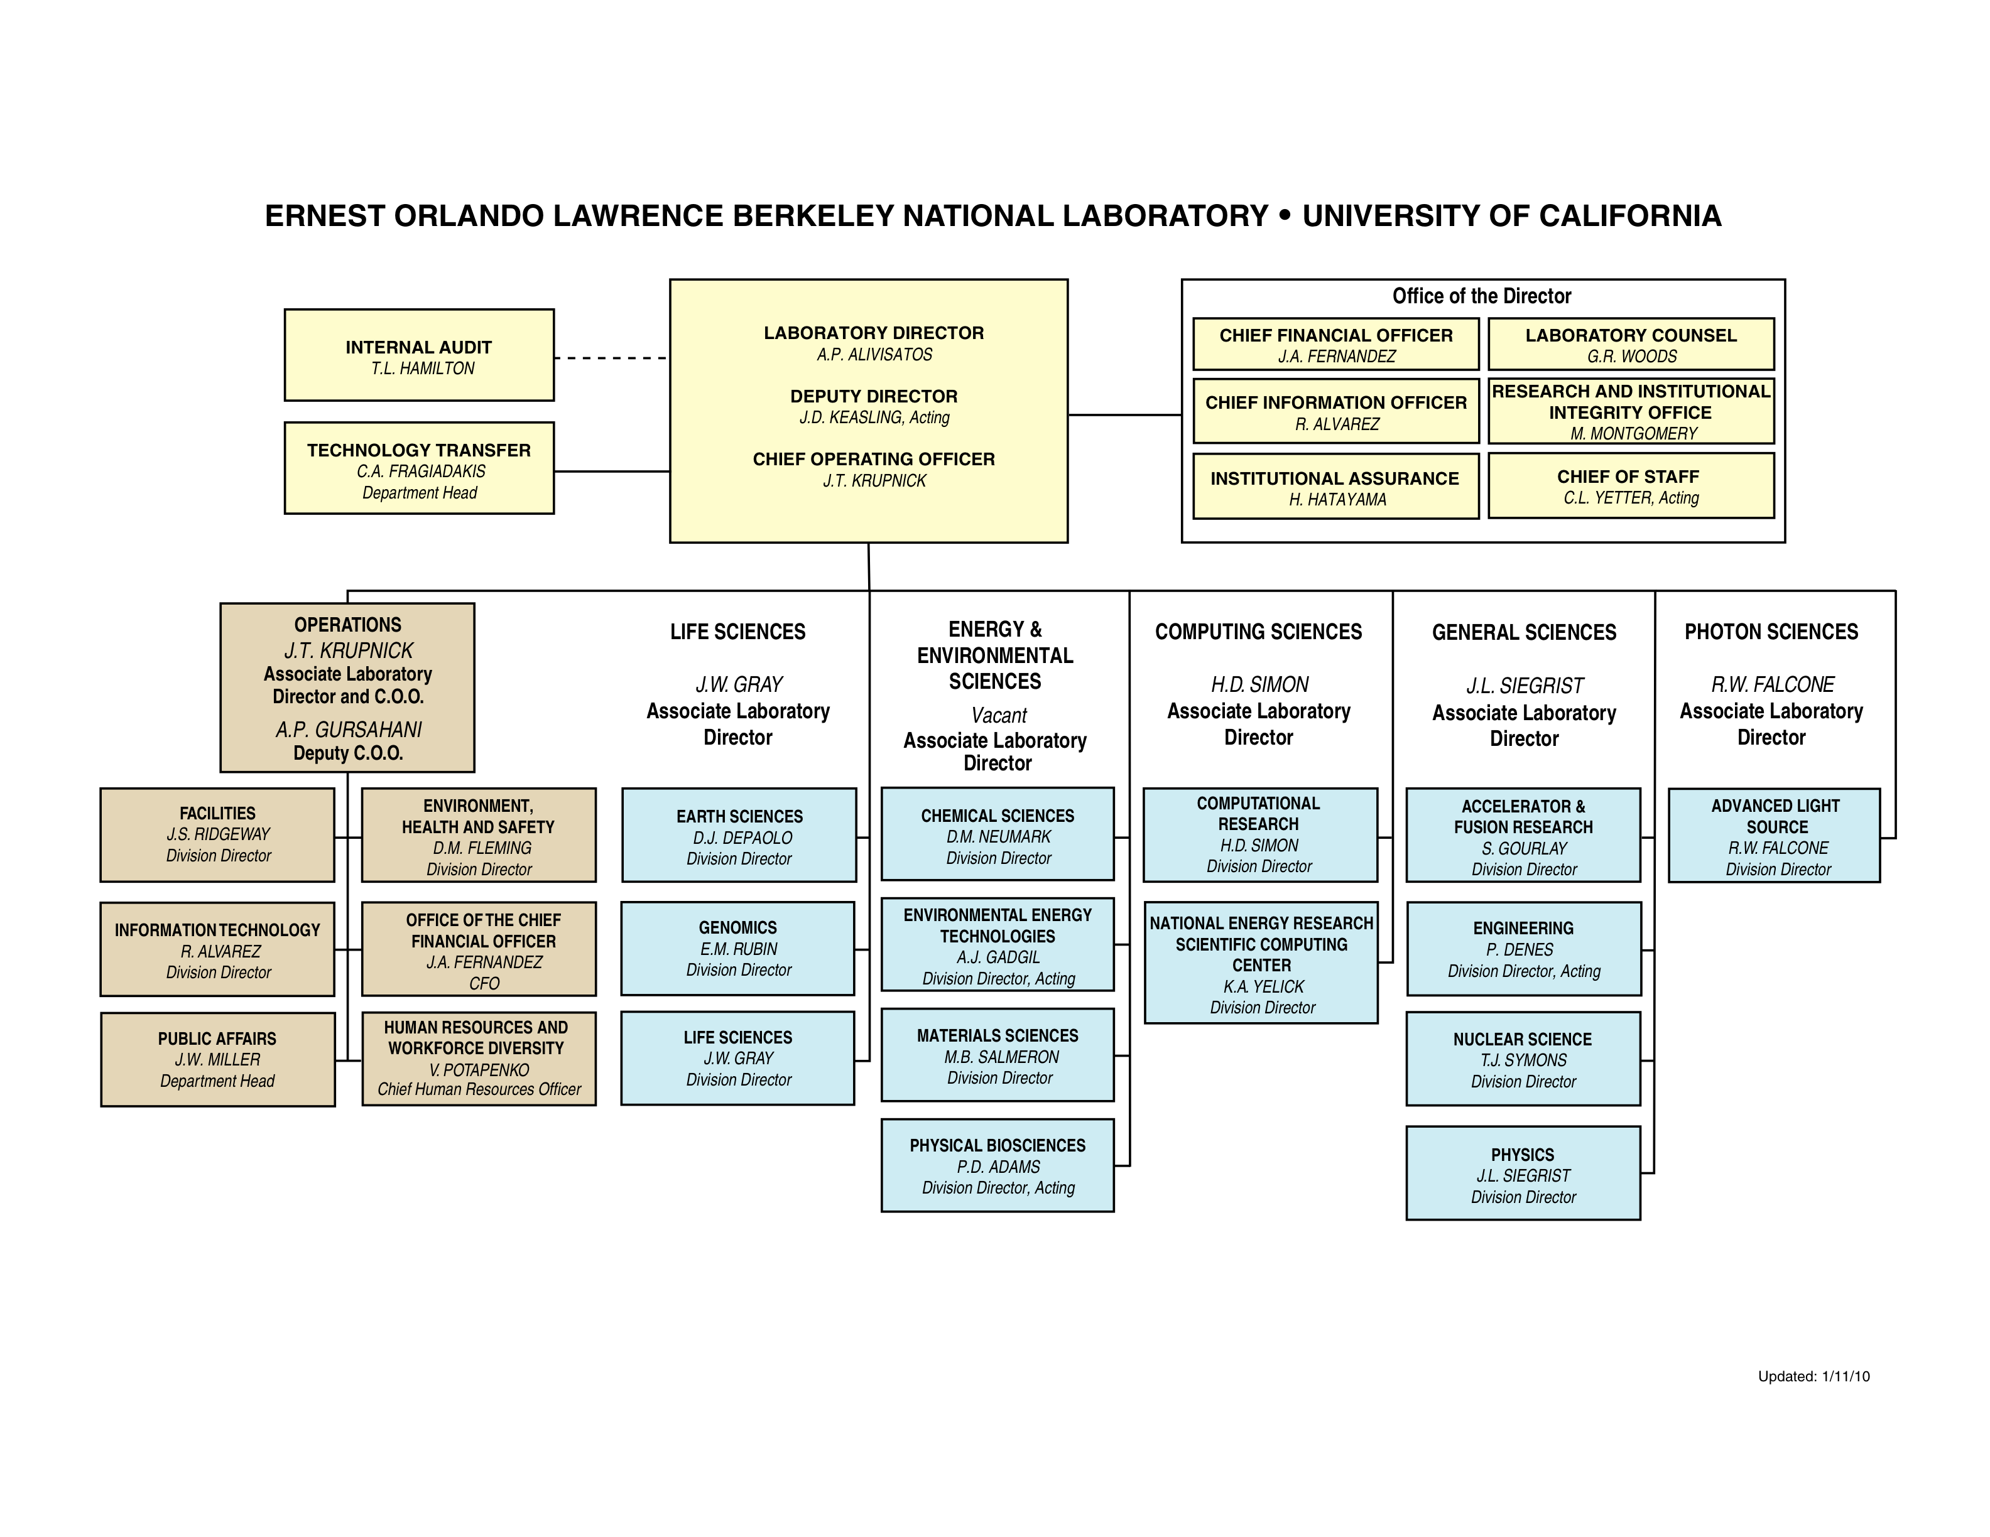
Laboratory Organization Chart

Slide 3
Berkeley Lab’s Tech Transfer Mission
Promote the use of Berkeley Lab technology to benefit society
Create, support and maintain research partnerships with industry
Secure fair compensation for Lab technologies
Contribute to regional and national economic development

Slide 4



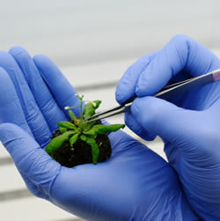
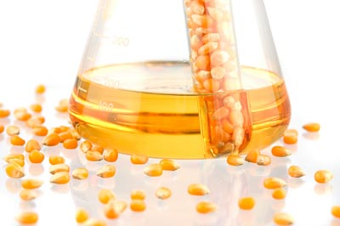
Technology Transfer and Intellectual Property Management Activities
Intellectual Property Assessment and Licensing
Marketing of Technologies and Research Capabilities
Patenting and Other IP Protection
Collaborative Research Development

Slide 5
Simplified Flow Diagram (inventions, US patents, licenses)
Start
Market Invention
Researcher files
Invention Disclosure
- Web
- Direct Mail
- Trade Shows
- Company Visits
Contract Mgm’t
For 20 Yrs.
Successfully Executed License
Draft and File
Provisional
Application
Evaluate
1. Co. Interest
2. Commer. Potential
Positive
Negotiate and Execute Licenses
Evaluate
(Apply for
Patent?)
Evaluate
Patent
every
4 Years.
No
Yes,
Provisional
Still
interested
No
Longer
interested
Yes,
Regular
No Interest or Potential
Draft and File
Regular
Application
Office Actions
And Responses
Pay Issue Fees
and Maintenance
Fees
Transfer to DOE
Does not include:
- Copyrights, trademarks, tangible research products
- Patents in foreign countries, divisionals, continuations, re-examinations, interferences
Responsibility:
Researcher function
Patent group
Licensing and Marketing
TTIPM

Slide 6
Philosophy and Process
Encourage lots of quality disclosures
Make available technologies widely known
Make extensive use of lower cost provisional patent applications
Use in-house counsel especially to file “at risk”
Pursue a fair return
Provide service to the researchers

Slide 7
Responsibilities of Tech Transfer
Licensing Berkeley Lab inventions and software, and managing those licenses for the many years they are in place (~ 300 active licenses)
Patenting Berkeley Lab inventions (~ 290 US patents)
Developing research partnerships with the private sector (~$100 million in partnership portfolio since 1994)
Marketing the lab’s capabilities and inventions (promoted > 450 Lab inventions)
Serving as primary interface with the private sector and representing the Lab at various entrepreneurial, commercial, and regional economic development activities
Notes:
This staff has been responsible for
over 300 patent and software licenses,
for developing research partnerships valued at over 100M dollars.
For marketing hundreds of Lab inventions and for
Representing the Lab as its primary interface with the private sector
Now I’m going to tell you a little about the research partnership development activity

Slide 8

Licensing
Invention assessment
Patenting decisions
Negotiation of licenses
License maintenance
Support Lab researchers in moving materials, developing businesses, etc
Notes:
I’ve already gone over the responsibilities of the Technology Transfer Department

Slide 9
Marketing Goals
Attract qualified licensees and research partners
Meet fairness of opportunity requirements
Collect industry feedback on LBNL techs
Build long term relationships
Increase recognition of LBNL
Deliver internal education on technology transfer
Notes:
We complement researchers success
federal
LBNL v LLNL v UCB
(don’t call internal training ‘very large”

Slide 10
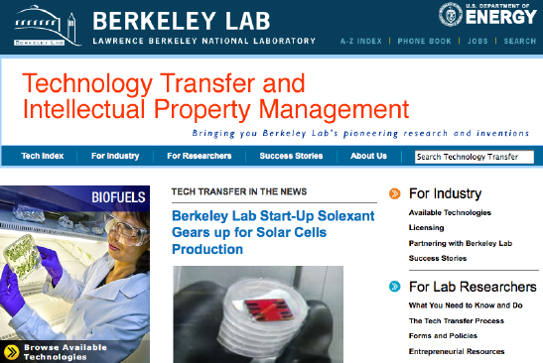
Industrial Outreach/Marketing Vehicles
Technology Transfer website
  www.lbl.gov/tt
Technology Announcements
Meetings, conferences, visits
Technology Transfer collateral
Internal training and inventor resources
DOE Technology Commercialization Fund
Entrepreneur in Residence Program

Slide 11

Patents
Obtain patent protection for selected technologies
  Draft, prosecute and maintain patents
  Manage external counsel
  Manage DOE obligations and interface
  Review licenses
Review of consulting agreements
Publication review
Dispute management
Notes:
The Responsibilities of the Patent Departmetn are complementary.
The primary responsibility is to obtain patent protection for selected technologies.
The Patent Dept also supports the Lab in its Export control requiremetns.
It reviews consulting agreements for appropriate IP notifications and terms
It reviews publications
And it participates in dispute resolution.

Slide 12
Why Are Your Deliverables Important To Us?
Licensing professionals are each managing hundreds of cases, seldom get to do the “deep dive” into the technology or application
You may find a new market or application
You may save us money
You may provide the scientist with valuable insight

Slide 13
Tips In Dealing With Inventors
Do your homework; read the invention description and any other material offered
Discuss among your team members; let the technical member be your interpreter
Schedule a meeting at least a week in advance if possible
Prepare both general and specific questions
Consider recording the meeting if the scientist agrees
If you are going to ask for feedback on your intermediate work, make sure you give plenty of time

Slide 14
Resources In The Tech Transfer Office
Licensing, marketing, patenting professionals
Direct POC is Shanshan Taylor (sltaylor@lbl.gov or 510-486-5366)
Alternate contact is Cheryl Fragiadakis (cafragiadakis@lbl.gov or 510-486-7020)

Slide 15


